Slide 1
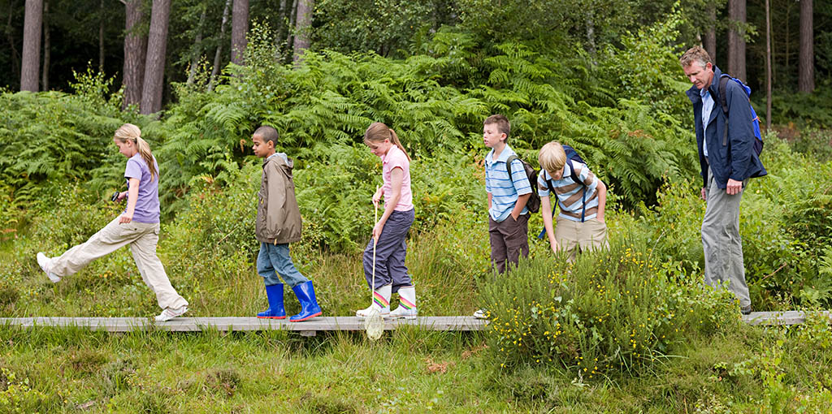
Alternative methods to estimate abundance

Slide 2
A menu of options
Abundance assessment techniques
Estimates
Indices
All individuals seen
Some individuals not seen
Complete Census
Capture
Census on sample plot
Removal
Capture-Mark-Recapture
Transect
Sightability models
Distance sampling
Double sampling Multiple observers

Slide 3
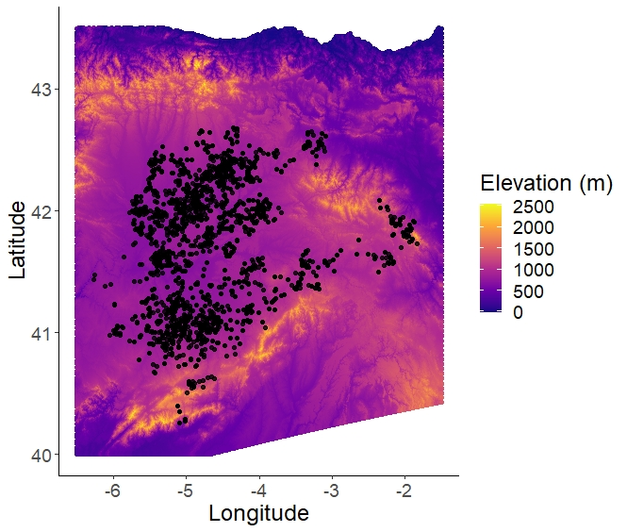
Indirect methods to estimate population size
Why indirect?
Lower cost
Both financial and time
Wider coverage
Less bias
Better sampling design
Less bias
Allows estimation of spatial distribution
Good for hard to trap species
Spanish vole surveys
85,000 samples
Over 10 years
From area the size of Scotland

Slide 4
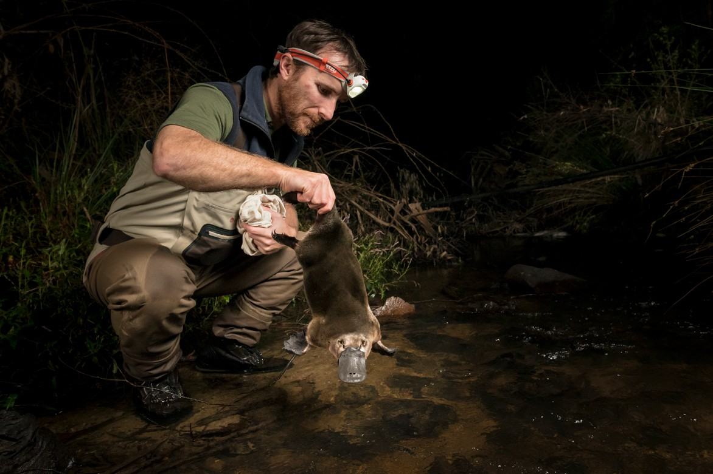
Platypus hunters
Very cryptic species
Over multiple nights of trapping, you might catch 1 or 2 individuals
Switch from direct methods to estimate abundance (e.g. closed CMR) to indirect methods
In their case, they switched to using environmental DNA (eDNA)

Slide 5
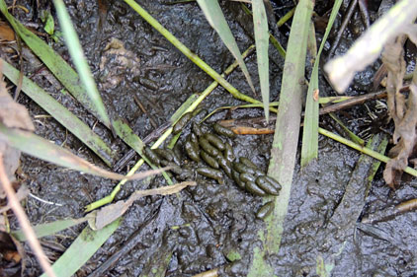
Two broad types of population indices
Presence-absence indices
An area is occupied or not
Focus of occupancy models (next week)
Abundance indices
Conditional on signs of activity being correlated with abundance

Slide 6
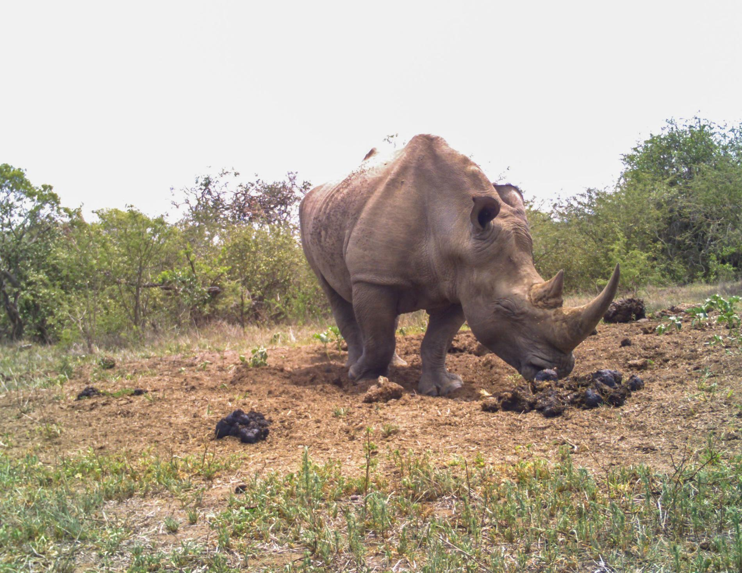
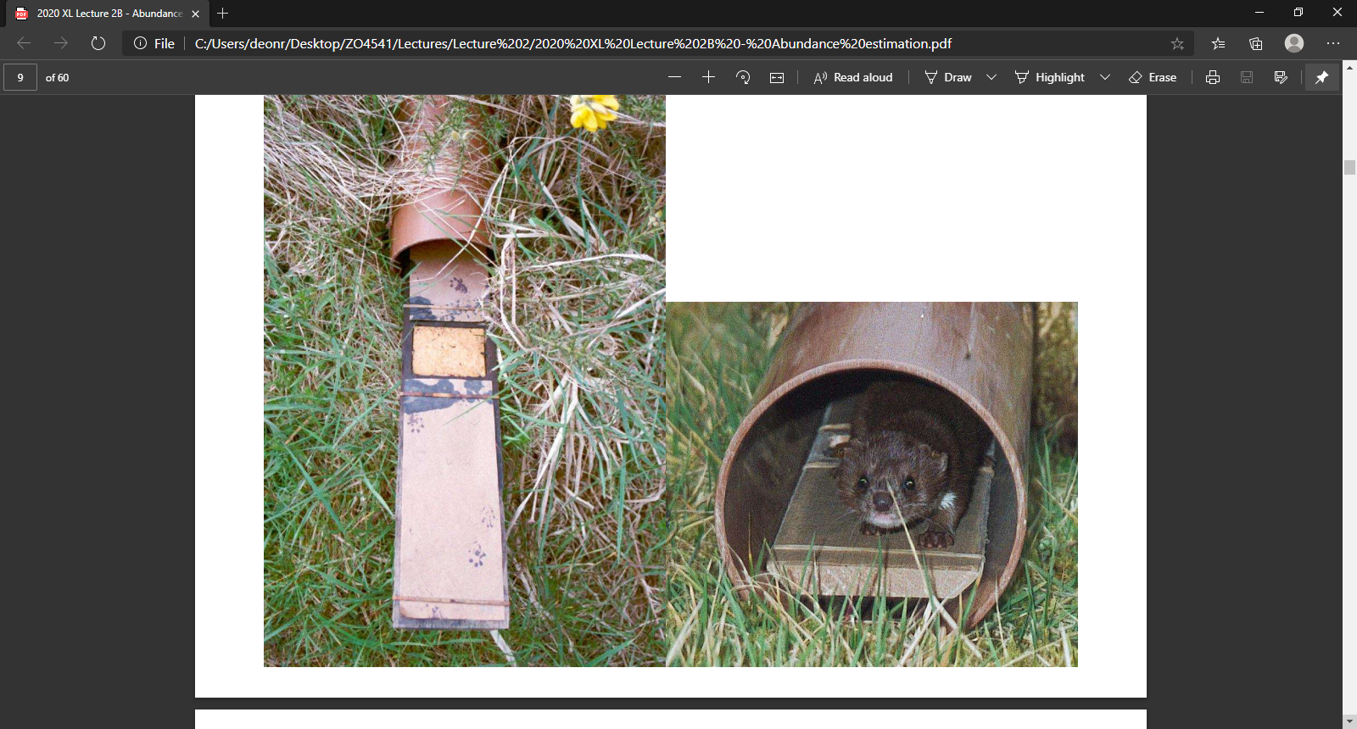
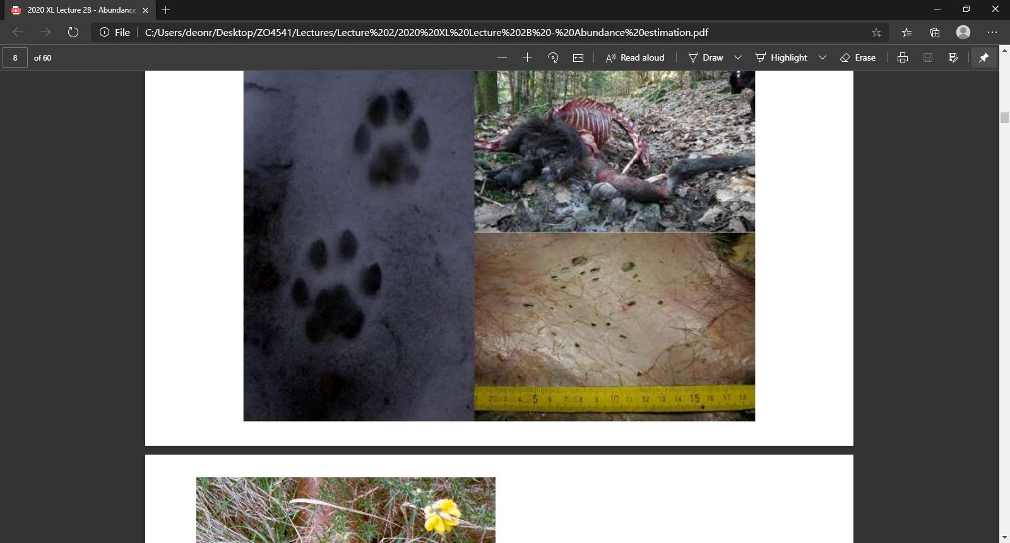
Three types of abundance indices
Indirect measures of presence-absence
Burrows, latrines, dens, eDNA
Number of detections
But may not increase with density
Indirect measures of activity
Footprints, baits, hair tubes, scrapes
But may be influence by factors other than abundance (e.g. food availability)
Induced response
Scent stations, playback, baits, camera traps
But may selectively sample a fraction of the population

Slide 7
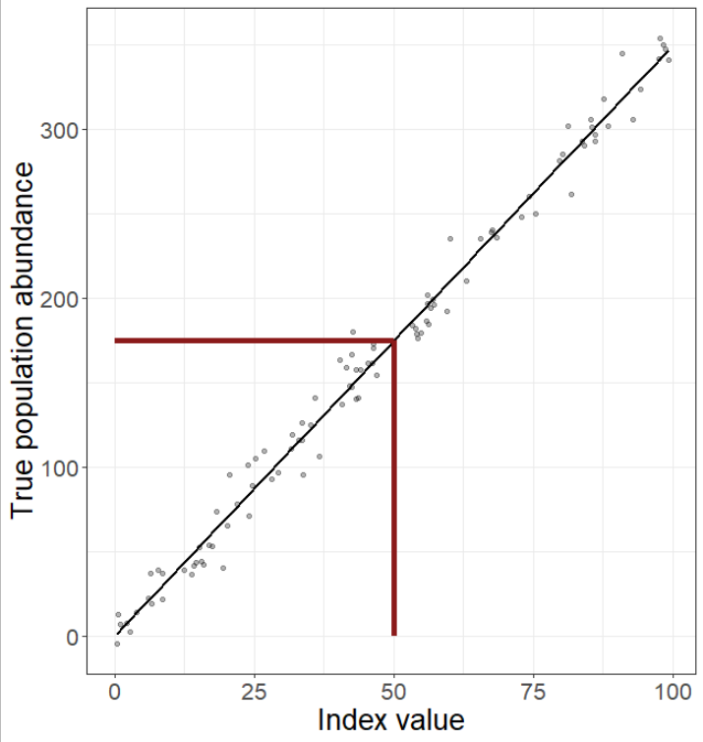
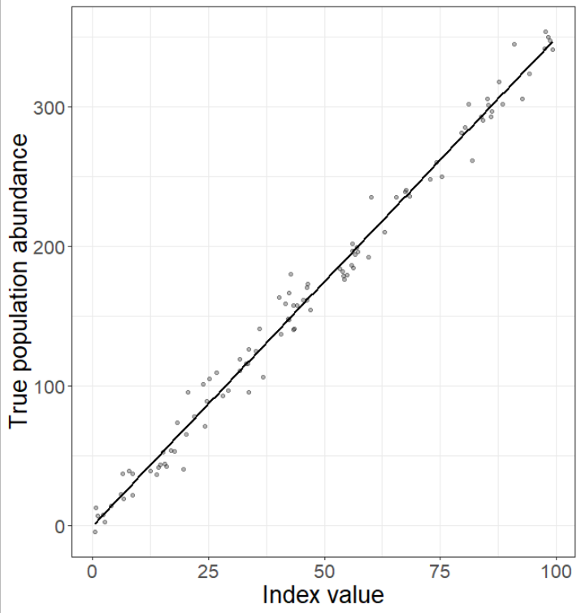
Index must be correlated with abundance
A population index is a measurement which is assumed to be correlated with true population size
E.g. every animal poops 5 times, so 10 poops = 2 animals
Valid when the relationship is a straight line
y = mx + c
~Kind of

Slide 8
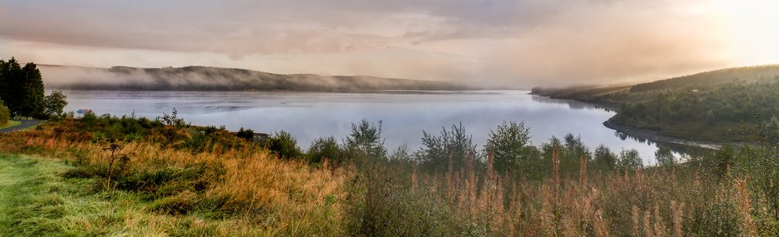
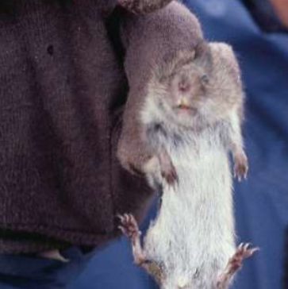
Case study: Field vole indices

Slide 9
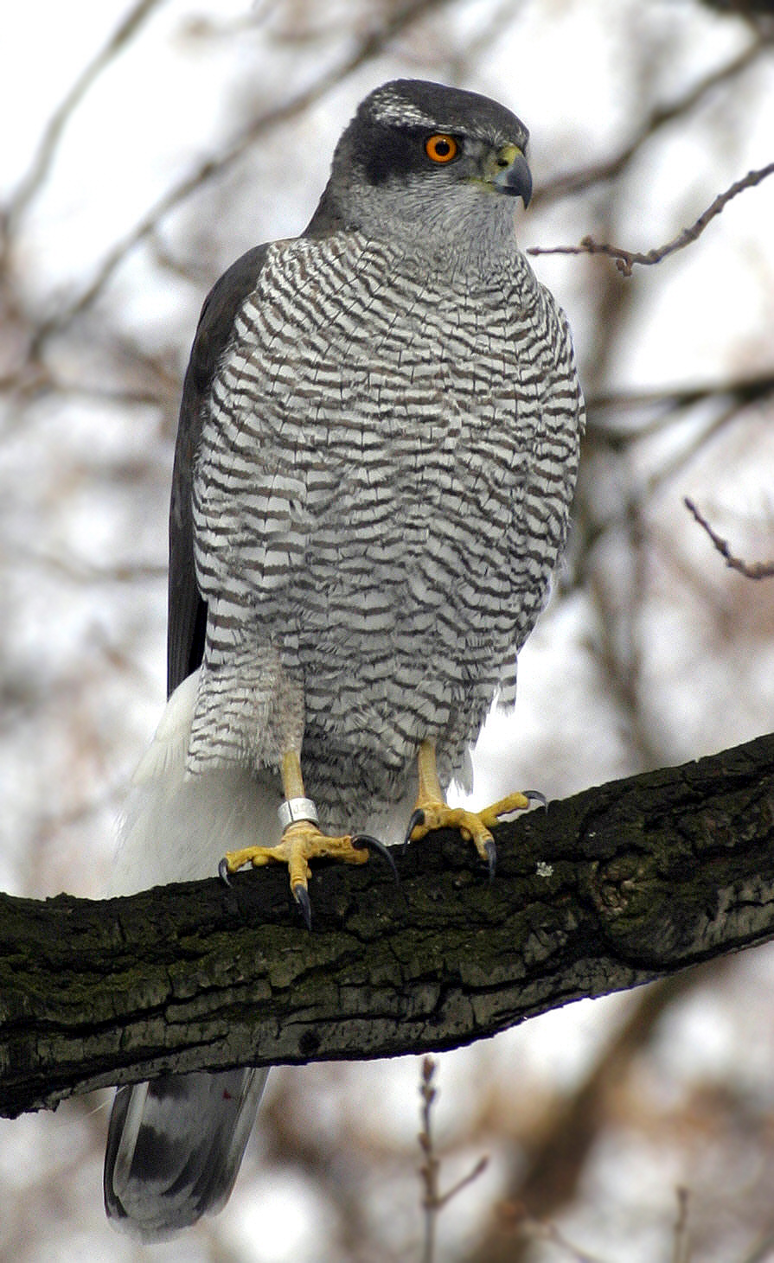
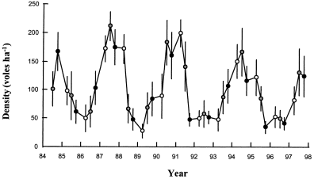
Why monitor voles?
Field voles in Kielder Forest
Field voles have population cycle (and traveling wave)
Long term monitoring of prey species
Eaten by Tawny owls and goshawks etc.
Monitoring voles to determine how susceptible predators are to sudden lack of prey

Slide 10
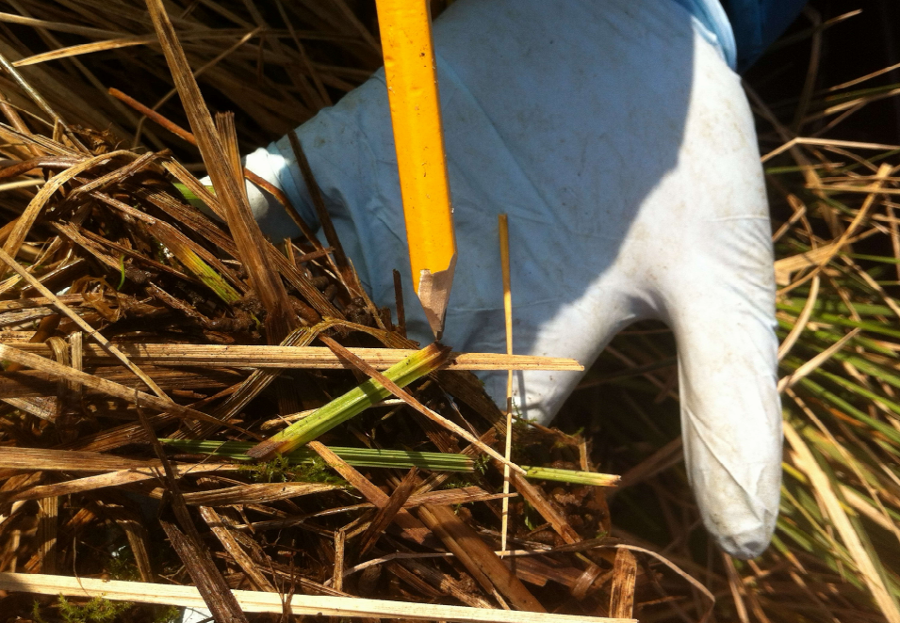
Field vole index
Sampling design of abundance index
Survey in grassland
A presence-absence score of fresh feeding clippings
Grass clippings with non-oxidised, non-yellowed edges with a bite mark
25 quadrats (50 cm x 50 cm) thrown at > 20 m spacing
The abundance index is then
Out of 25 quadrats, X had signs of vole activity

Slide 11
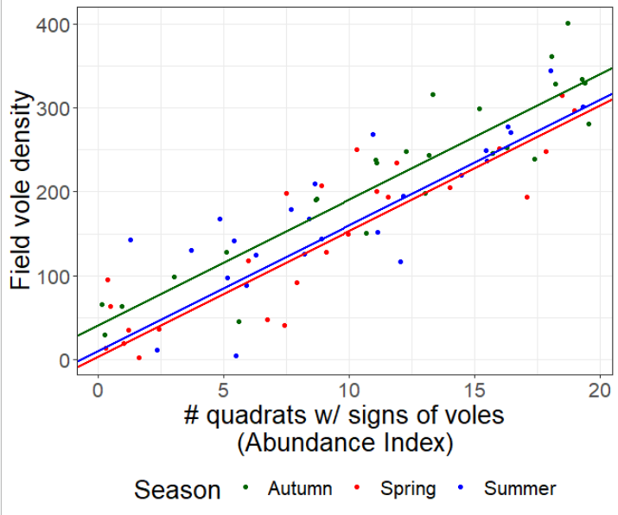
Which gave…
Calibrated against densities estimated via closed CMR models
Led to a good, linear calibration
R² = 0.78 so strongly correlated
Found season specific intercepts
Due to variation in yellowing of grass clippings over seasons

Slide 12
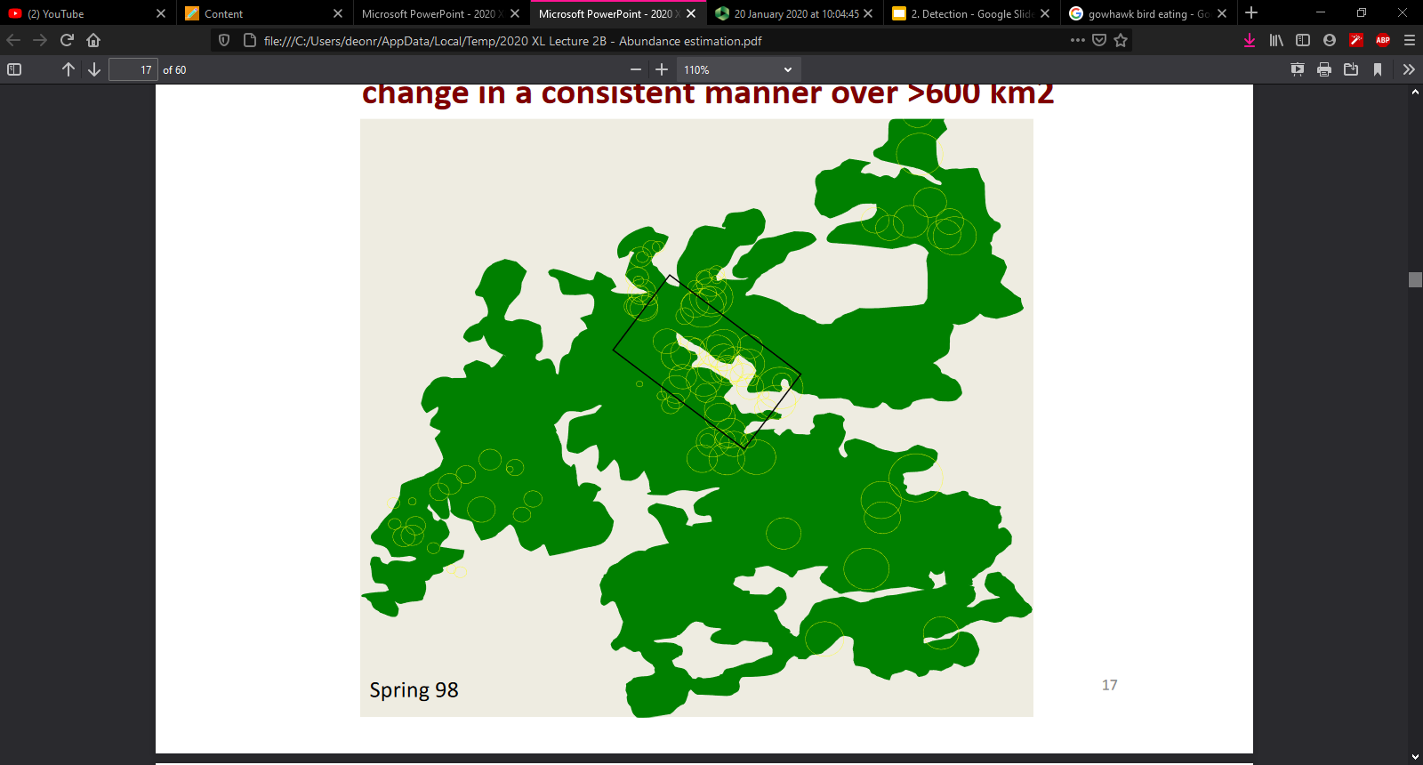
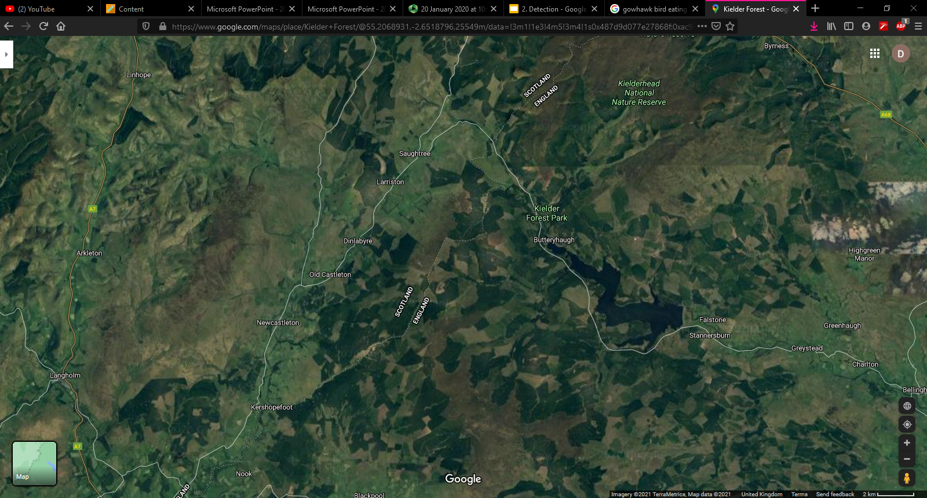
Which allows…
You can now repeat surveys across while landscape to estimate vole abundance
But crucially, these can only be done in grasslands
Relationship in other habitats is potentially different
Indices allow rapid, if crude, assessments of abundance.

Slide 13
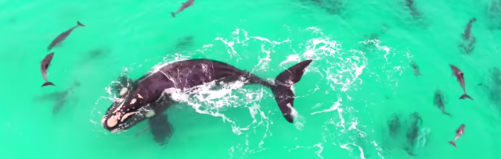
Distance sampling

Slide 14
A menu of options
Abundance assessment techniques
Abundance assessment techniques
Estimates
Estimates
Indices
Indices
All individuals seen
All individuals seen
Some individuals not seen
Some individuals not seen
Complete Census
Complete Census
Capture
Capture
Removal
Census on sample plot
Removal
Census on sample plot
Capture-Mark-Recapture
Capture-Mark-Recapture
Transect
Transect
Sightability models
Sightability models
Distance sampling
Distance sampling
Double sampling Multiple observers
Double sampling Multiple observers

Slide 15
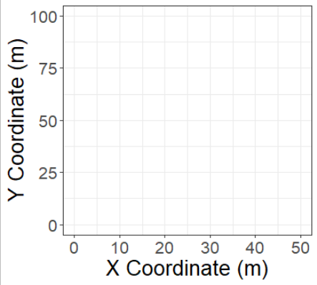
A study site

Slide 16
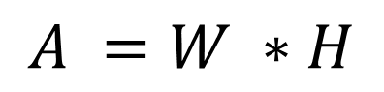
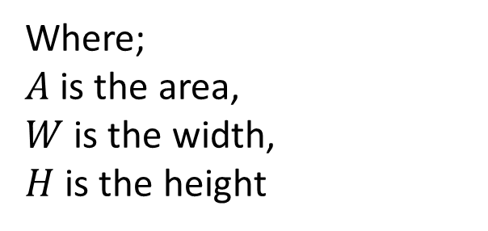
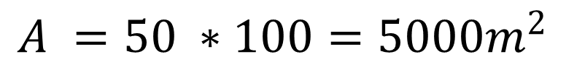
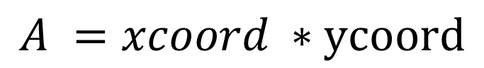
What is the area of the study site?
$$A =W ∗H$$
$$A =xcoord ∗ycoord$$
$$A =50 ∗100=5000m^{2}$$
Where;
$A$ is the area,
$W$ is the width,
$H$ is the height

Slide 17
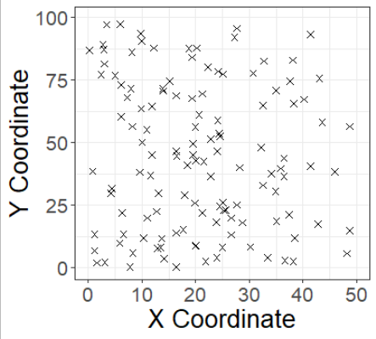
A study site with animals

Slide 18
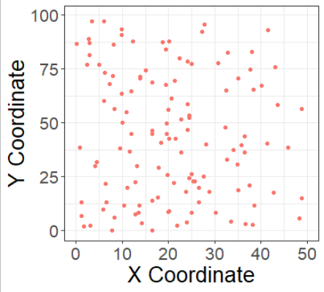
A complete census of those animals

Slide 19
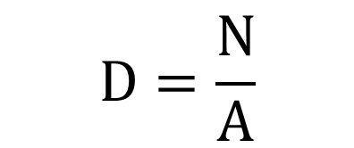
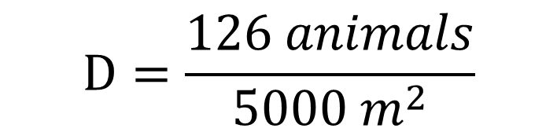
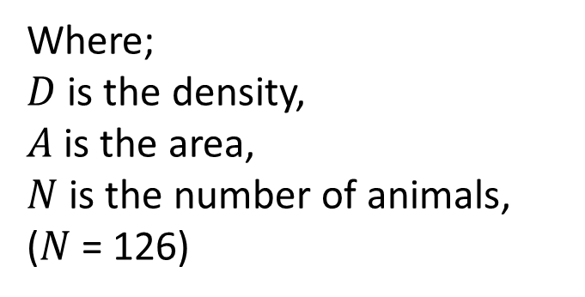
What is the density of animals?
$$D=\frac{N}{A}$$
$$D=\frac{126 animals}{5000{ m}^{2}}$$
$$D=0.02 animals per{ m}^{2}$$
$$D=25.2 animals per{ km}^{2}$$
Where;
$D$ is the density,
$A$ is the area,
$N$ is the number of animals,
($N$= 126)

Slide 20
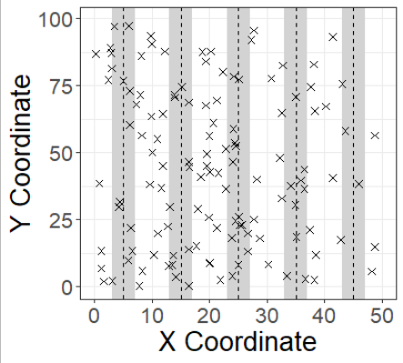
Instead of census, transects

Slide 21
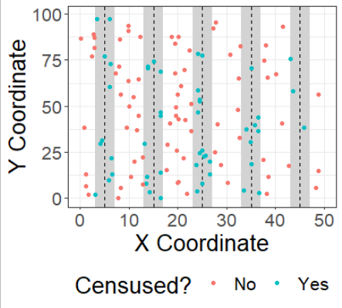
Censuses within transects

Slide 22
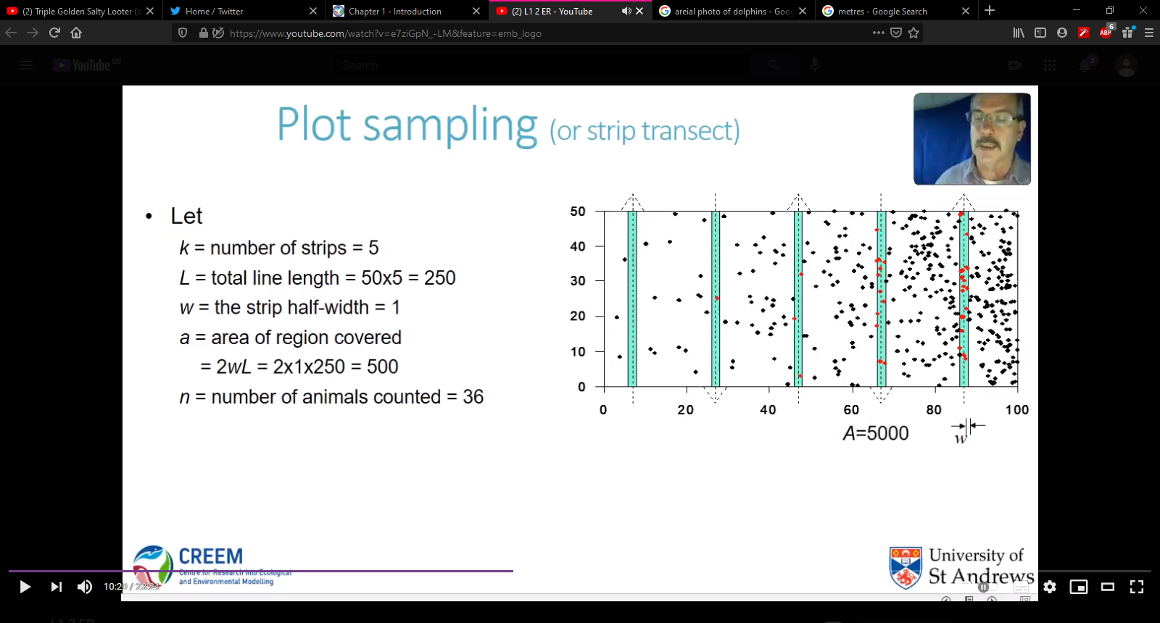
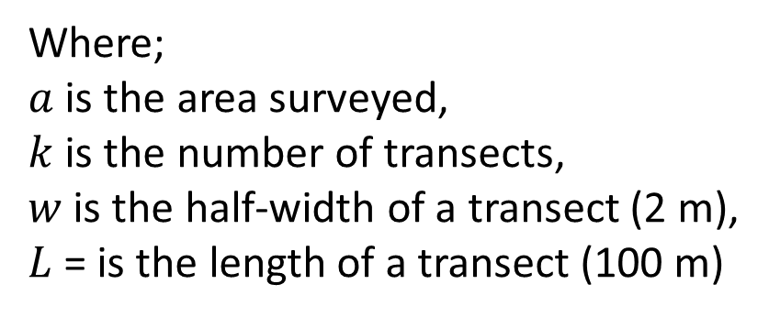
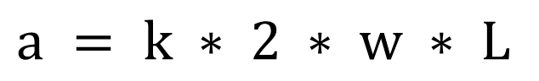
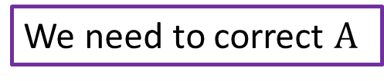
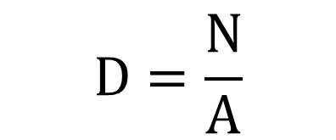
What is our population size estimate?
$$D=\frac{N}{A}$$
We need to correct $A$
$$a = k ∗ 2 ∗ w ∗ L$$
$$a =5 ∗ 2 ∗2 ∗100=2000{ m}^{2}$$
Where;
$a$ is the area surveyed,
$k$ is the number of transects,
$w$ is the half-width of a transect (2 m),
$L$= is the length of a transect (100 m)

Slide 23
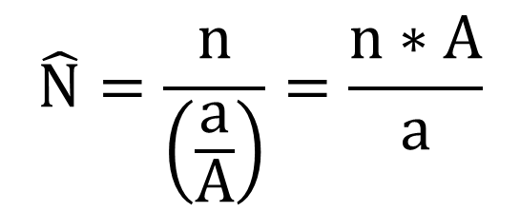
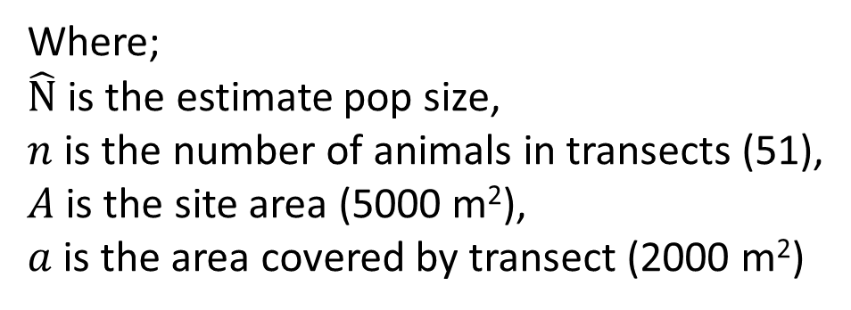
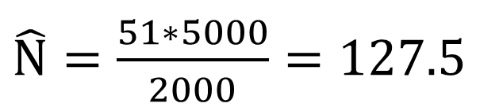
What is our population size estimate?
$$\hat{N}=\frac{n}{\left(\frac{a}{A}\right)}=\frac{n∗A}{a}$$
$\hat{N}=\frac{51∗5000}{2000}=127.5$
True N = 126
Where;
$\hat{N}$ is the estimate pop size,
$n$ is the number of animals in transects (51),
$A$ is the site area (5000 m²),
$a$is the area covered by transect (2000 m²)

Slide 24
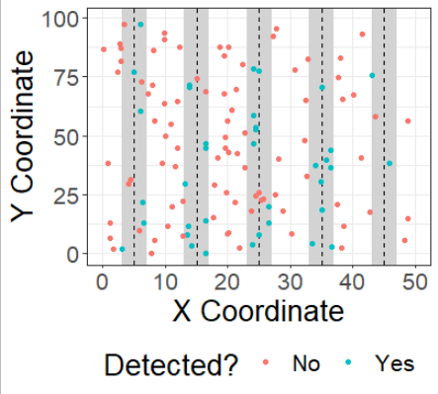
Transects with imperfect detection

Slide 25
Dealing with imperfect detection
Not all animals are seen
Incomplete registration
There is an underlying probability for an animal to be seen
P_{a} is the probability to be seen within a transect
Let’s assume we know that P_{a} = 0.7

Slide 26
What’s the population size estimate now?
We observed 38 animals
If the probability to see any animal was 0.7
Then 38/0.7 is the true number of animals in a transect = 54.3
We surveyed 2000 m2 of 5000 m2 site, so 2000/5000
We estimate there are 54.3/(2000/5000) = 135.75 animals
True N = 126

Slide 27
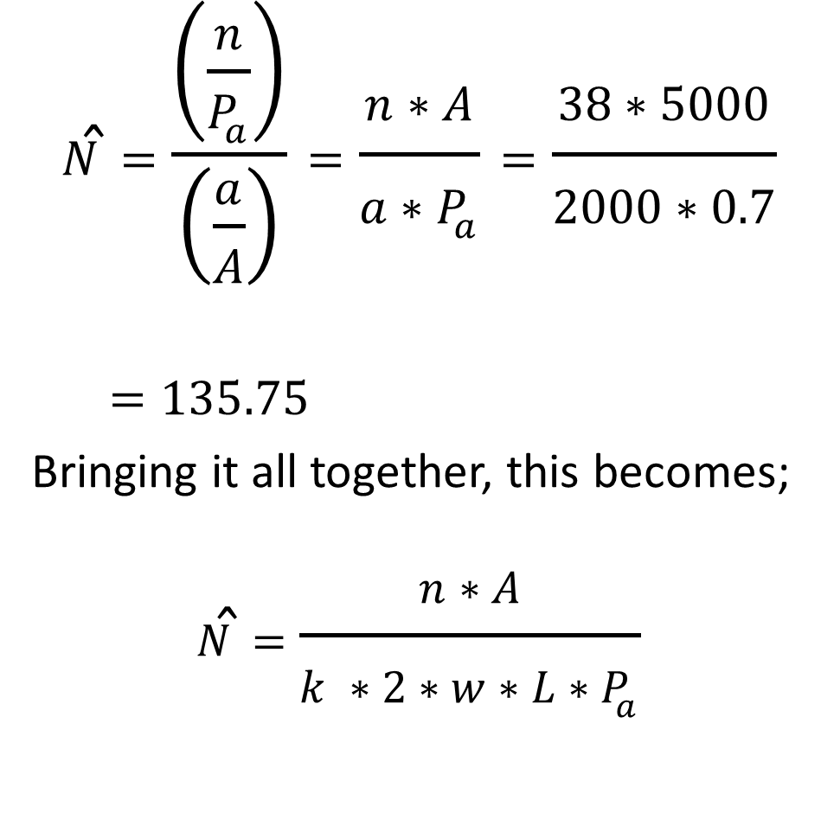
The same but mathematically
$$\hat{N}=\frac{\left(\frac{n}{P_{a}}\right)}{\left(\frac{a}{A}\right)}=\frac{n∗A}{a∗P_{a}}=\frac{38∗5000}{2000∗0.7}$$
$$=135.75$$
Bringing it all together, this becomes;
$$\hat{N}=\frac{n∗A}{k ∗2∗w∗L∗P_{a}}$$

Slide 28
A complication
Spot the orangutan nest

Slide 29
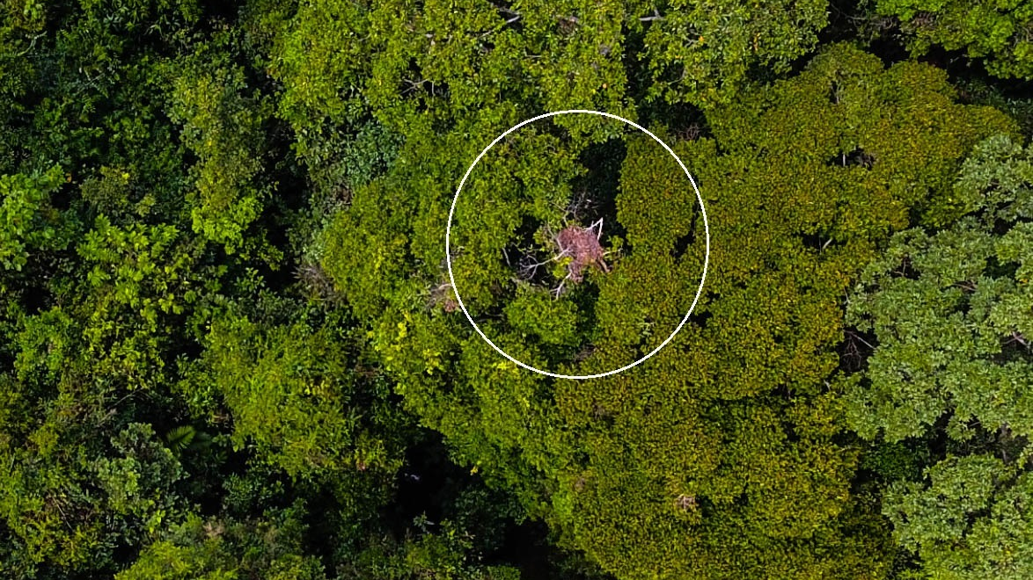
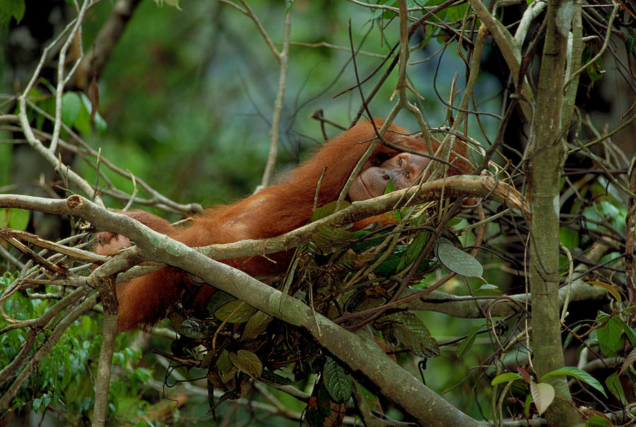

Slide 30
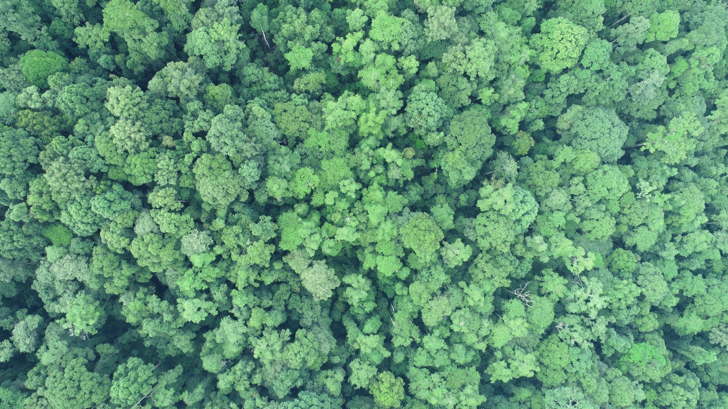

Slide 31
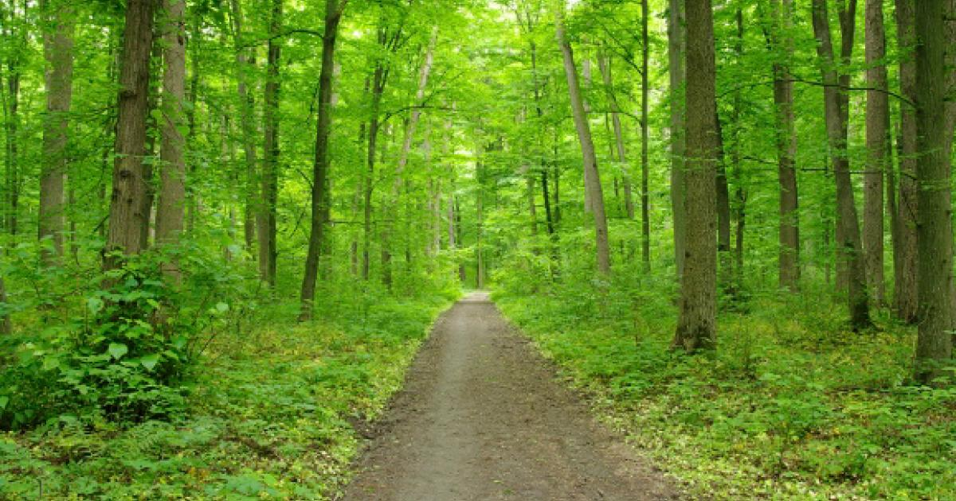
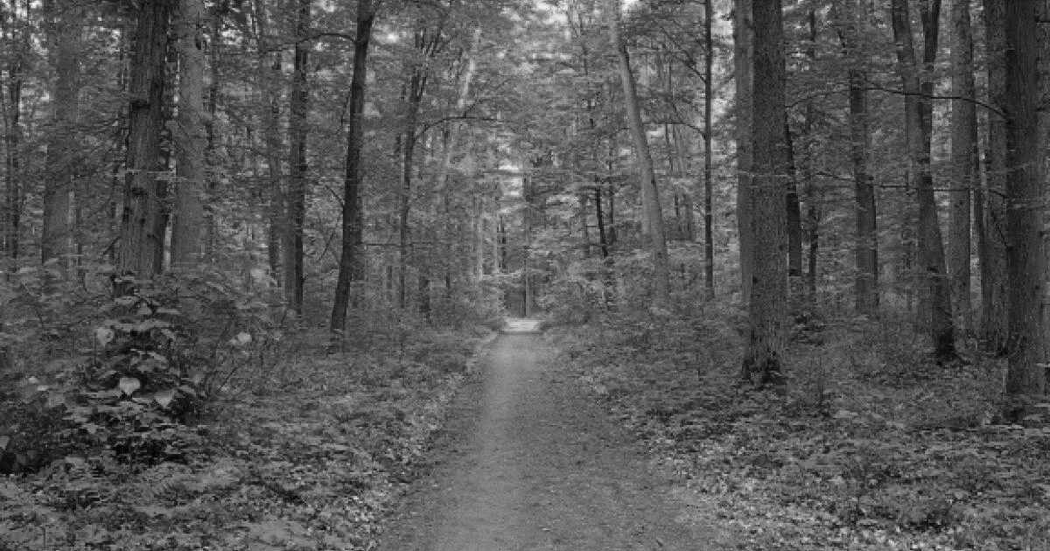
The further away things are, the harder to see
E.g. 100%
Our detection probability declines the further away the animal is
When animals are close to the centre of the transect (i.e. where we’re walking) the easier it is to spot them.
The further away they are, the harder they are to spot.
E.g. 5%
Distance from path

Slide 32
Distance dependent detection is the hallmark of distance sampling
We assume we saw all animals at zero distance
9
Number of animals seen
0
0
Perpendicular distance from line transect
2

Slide 33
Distance dependent detection is the hallmark of distance sampling
We can fit a line to the histogram to describe animals encountered (red line)
Number of animals seen
Perpendicular distance from line transect

Slide 34
Distance dependent detection is the hallmark of distance sampling
If we saw every animal, we have a perfect rectangle (purple box)
Number of animals seen
Perpendicular distance from line transect

Slide 35
Distance dependent detection is the hallmark of distance sampling
Therefore, purple striped area indicates the animals we never encountered
Number of animals seen
Perpendicular distance from line transect

Slide 36
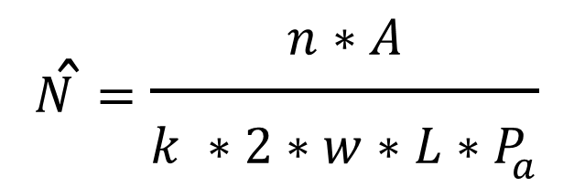
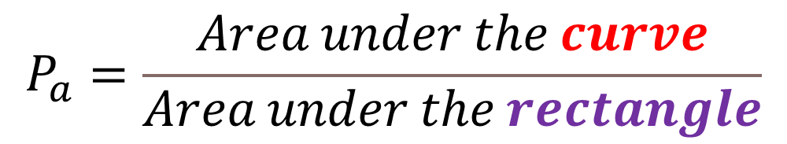
Distance dependent detection is the hallmark of distance sampling
$$\hat{N}=\frac{n∗A}{k ∗2∗w∗L∗P_{a}}$$
$$P_{a}=\frac{Area under the curve}{Area under the rectangle}$$
Number of animals seen
Perpendicular distance from line transect

Slide 37
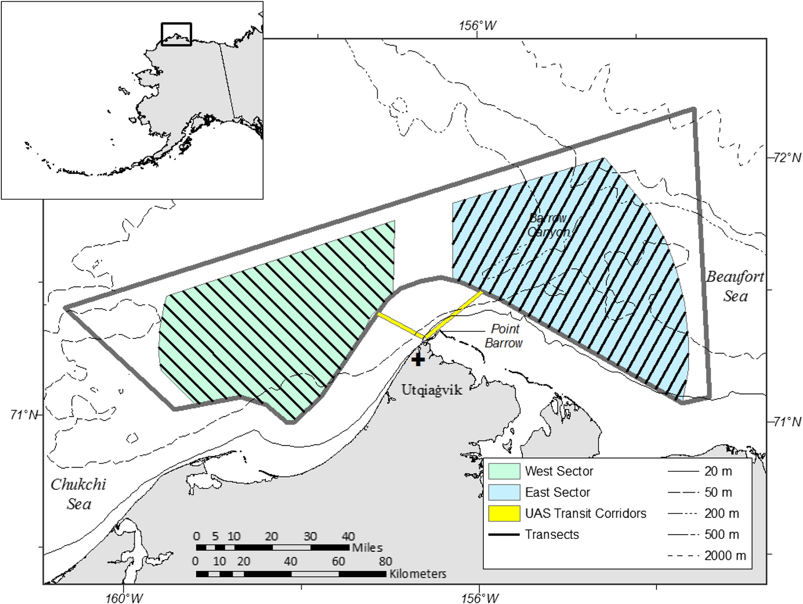
Sampling
Transects are ideally evenly spaced
Initial placement is “random”

Slide 38
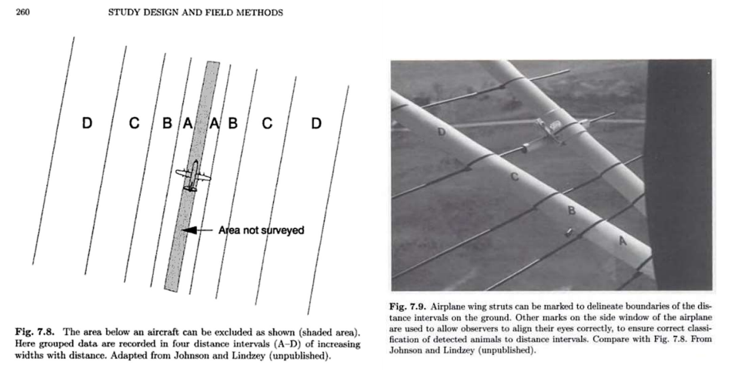
To estimate distance

Slide 39
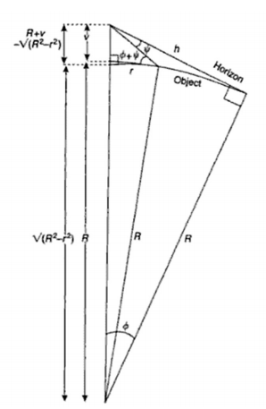


To estimate perpendicular distance

Slide 40

A variant of distance sampling
Point sampling
A.k.a. Static distance sampling
Same logic
The closer the animal to your location, the better the detection
Conceptually very similar to a variant of closed CMR
Spatially-explicit-capture-recapture (SECR)

Slide 41
tl;dr
Closed CMR is not the only option to estimate abundance
(It’s just the method taught in this class)
Abundance indices are a rapid fire, albeit crude, way to estimate abundances
Has many caveats
Requires calibration, often with closed CMR
Distance sampling seeks to solve same issues as closed CMR
But tailored for transects rather than trapping
Mixing distance sampling and closed CMR gives spatially explicit capture-mark-recapture (SECR)

